Slide 1
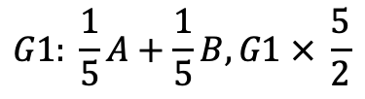
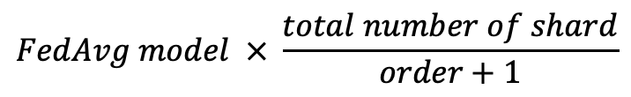
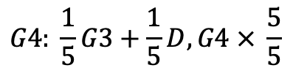
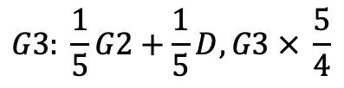
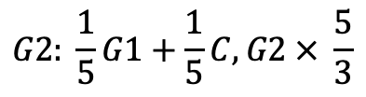
voting FedAvg
A, B, C, D, E
$$FedAvg model × \frac{total number of shard}{order+1}$$
$$G1: \frac{1}{5}A+\frac{1}{5}B, G1 × \frac{5}{2}$$
$$G2: \frac{1}{5}G1+\frac{1}{5}C, G2 × \frac{5}{3}$$
$$G3: \frac{1}{5}G2+\frac{1}{5}D, G3 × \frac{5}{4}$$
$$G4: \frac{1}{5}G3+\frac{1}{5}D, G4 × \frac{5}{5}$$

Slide 2
normal FedAvg
label | A+B |  |  | A+B+C |  |  | A+B+C+D |  |  | A+B+C+D+E
round | 4 | 9 | 10 | 4 | 9 | 10 | 4 | 9 | 10 | 4 | 9 | 10
0 | 84.75 | 97.67 | 94.92 | 90.48 | 100 | 100 | 80.95 | 98.08 | 100 | 89.66 | 96.72 | 96.55
1 | 64.38 | 97.01 | 98.63 | 82.67 | 92.42 | 98.67 | 45.71 | 92.75 | 97.14 | 79.1 | 94.29 | 98.51
2 | 98.44 | 90.91 | 93.75 | 94.83 | 81.43 | 93.1 | 75.44 | 75 | 77.19 | 64.86 | 78.12 | 85.14
3 | 98.25 | 100 | 98.25 | 98 | 87.5 | 94 | 84.62 | 81.16 | 87.69 | 66.67 | 70 | 88.33
4 | 0 | 0 | 0 | 82.54 | 96.67 | 85.71 | 84.29 | 96.05 | 95.71 | 65.45 | 71.64 | 74.55
5 | 0 | 0 | 0 | 69.09 | 91.67 | 90.91 | 75.51 | 95.92 | 89.8 | 90.32 | 96.23 | 96.77
6 | 0 | 0 | 0 | 0 | 4.26 | 11.86 | 87.3 | 79.07 | 84.13 | 83.33 | 69.84 | 89.39
7 | 0 | 0 | 0 | 0 | 0 | 0 | 96.83 | 91.55 | 100 | 95.95 | 73.13 | 93.24
8 | 0 | 0 | 0 | 0 | 1.39 | 3.12 | 0 | 1.35 | 1.39 | 69.57 | 68.97 | 71.01
9 | 0 | 0 | 2.99 | 0 | 0 | 0 | 0 | 1.75 | 3.57 | 46.51 | 86.15 | 76.74
Accuracy | 36.02 | 40.28 | 41.08 | 51.71 | 56.07 | 58.61 | 69.66 | 73.77 | 77.09 | 80.5 | 86.09 | 91.98
F1 Score | 22.93 | 24.83 | 26.11 | 40.1 | 44.3 | 45.49 | 63.07 | 67.14 | 69.64 | 80.6 | 86.22 | 91.95

Slide 3
round4 + round9
label | A4+B4 | A4+B9 | A9+B4 | A9+B9 | G1+C4 | G1+C9 | G2+D4 | G2+D9 | G3+E4 | G3+E9
0 | 84.75 | 89.83 | 97.67 | 97.67 | 100 | 98.51 | 94.83 | 100 | 94.55 | 100
1 | 64.38 | 90.41 | 94.03 | 97.01 | 87.14 | 82.54 | 86.57 | 96.97 | 91.67 | 94.37
2 | 98.44 | 96.88 | 90.91 | 90.91 | 84.21 | 76.67 | 75.68 | 90 | 78.69 | 69.81
3 | 98.25 | 98.25 | 100 | 100 | 93.85 | 86.76 | 85 | 95 | 78.95 | 86.67
4 | 0 | 0 | 0 | 0 | 87.14 | 95.16 | 89.09 | 90 | 70.15 | 56.67
5 | 0 | 0 | 0 | 0 | 73.47 | 95.52 | 90.32 | 86.67 | 87.5 | 85.19
6 | 0 | 0 | 0 | 0 | 0 | 1.64 | 95.45 | 85.11 | 78.12 | 73.68
7 | 0 | 0 | 0 | 0 | 0 | 0 | 98.65 | 89.66 | 64.62 | 76.81
8 | 0 | 0 | 0 | 0 | 0 | 0 | 0 | 0 | 85.11 | 76.27
9 | 0 | 0 | 0 | 0 | 0 | 0 | 0 | 0 | 76.81 | 84.62
accuracy | 36.02 | 39.28 | 40.14 | 40.28 | 56.55 | 55.75 | 73.76 | 74.89 | 85.83 | 88.6
f1 | 22.93 | 24.12 | 25.06 | 24.83 | 43.7 | 44.02 | 66.48 | 67.31 | 85.76 | 88.57

Slide 4
round4 + round9
model | A4+B4 | A4+B9 | A9+B4 | A9+B9 | G1+C4 | G1+C9 | G2+D4 | G2+D9 | G3+E4 | G3+E9
voting (accuracy) | 9 | 1 | 0 | 10 | 20 | 10 | 20 | 20 | 20 | 30
voting (f1 score) | 9 | 1 | 0 | 10 | 20 | 10 | 20 | 20 | 20 | 30
label | G3+E4 | G3+E9 | G3+E4 | G3+E9
0 | 91.38 | 94.83 | 94.55 | 100
1 | 92.54 | 89.55 | 91.67 | 94.37
2 | 47.3 | 63.51 | 78.69 | 69.81
3 | 46.67 | 65 | 78.95 | 86.67
4 | 56.36 | 70.91 | 70.15 | 56.67
5 | 98.39 | 98.39 | 87.5 | 85.19
6 | 92.42 | 93.94 | 78.12 | 73.68
7 | 77.03 | 81.08 | 64.62 | 76.81
8 | 71.01 | 71.01 | 85.11 | 76.27
9 | 81.4 | 74.42 | 76.81 | 84.62
accuracy | 79.79 | 83.97 | 85.83 | 88.6
f1 | 79.22 | 83.88 | 85.76 | 88.57

Slide 5
round9 + round10
label | A9+B9 | A9+B10 | A10+B9 | A10+B10 | G1+C9 | G1+C10 | G2+D9 | G2+D10 | G3+E9 | G3+E10
0 | 97.67 | 100 | 81.4 | 100 | 93.65 | 98.51 | 94.83 | 100 | 90.91 | 98.46
1 | 97.01 | 97.33 | 95.52 | 97.33 | 72.86 | 98.41 | 100 | 98.48 | 93.33 | 97.18
2 | 90.91 | 86.21 | 98.7 | 96.55 | 89.47 | 91.67 | 90.54 | 91.43 | 85.25 | 90.57
3 | 100 | 94 | 100 | 98 | 83.08 | 97.06 | 95 | 97.5 | 85.53 | 85.33
4 | 0 | 0 | 0 | 0 | 98.57 | 91.94 | 94.55 | 95 | 74.63 | 66.67
5 | 0 | 0 | 0 | 0 | 91.84 | 88.06 | 91.94 | 88.33 | 89.06 | 88.89
6 | 0 | 0 | 0 | 1.69 | 3.17 | 8.2 | 90.91 | 91.49 | 90.62 | 85.96
7 | 0 | 0 | 0 | 0 | 0 | 5.36 | 94.59 | 96.55 | 90.77 | 92.75
8 | 0 | 0 | 0 | 0 | 0 | 0 | 2.9 | 0 | 85.11 | 76.27
9 | 0 | 1.67 | 0 | 3.33 | 0 | 0 | 2.33 | 1.54 | 85.51 | 86.15
accuracy | 40.28 | 39.55 | 40.19 | 41.08 | 56.94 | 58.05 | 77.04 | 76.97 | 91.44 | 92.25
f1 | 24.83 | 24.43 | 25.73 | 26.11 | 45.31 | 44.75 | 69.42 | 69.35 | 91.42 | 92.21

Slide 6
round4 + round9
label | A9+B9 | A9+B10 | A10+B9 | A10+B10 | G1+C9 | G1+C10 | G2+D9 | G2+D10 | G3+E9 | G3+E10
voting (accuracy) | 0 | 10 | 10 | 0 | 10 | 20 | 27 | 13 | 10 | 40
voting (f1 score) | 0 | 10 | 10 | 0 | 10 | 20 | 27 | 13 | 10 | 40
A10+B10
worker0 | worker1 | worker2 | worker3 | worker4 | worker5 | worker6 | worker7 | worker8 | worker9
98.84 | 99.05 | 99.04 | 98.92 | 98.96 | 99.05 | 99.11 | 99.06 | 99.04 | 98.94
99.42 | 99.52 | 99.52 | 99.46 | 99.48 | 99.52 | 99.55 | 99.53 | 99.52 | 99.47
worker0 | worker1 | worker2 | worker3 | worker4 | worker5 | worker6 | worker7 | worker8 | worker9
98.27 | 98.72 | 98.8 | 98.6 | 97.48 | 99.09 | 97.82 | 99.34 | 98.45 | 98.55
99.12 | 99.35 | 99.4 | 99.29 | 98.72 | 99.54 | 98.89 | 99.67 | 99.22 | 99.26
worker0 | worker1 | worker2 | worker3 | worker4 | worker5 | worker6 | worker7 | worker8 | worker9
0 | 0 | 0 | 0 | 0 | 0 | 0 | 0 | 0 | 0
0 | 0 | 0 | 0 | 0 | 0 | 0 | 0 | 0 | 0
worker0 | worker1 | worker2 | worker3 | worker4 | worker5 | worker6 | worker7 | worker8 | worker9
0 | 0 | 0 | 0 | 0 | 0 | 0 | 0 | 0 | 0
0 | 0 | 0 | 0 | 0 | 0 | 0 | 0 | 0 | 0
worker0 | worker1 | worker2 | worker3 | worker4 | worker5 | worker6 | worker7 | worker8 | worker9
0.15 | 0.19 | 0.44 | 0.15 | 0.52 | 0.43 | 0.45 | 0.27 | 0.5 | 0.54
0.31 | 0.39 | 0.86 | 0.31 | 1.04 | 0.86 | 0.9 | 0.53 | 0.99 | 1.08

Slide 7
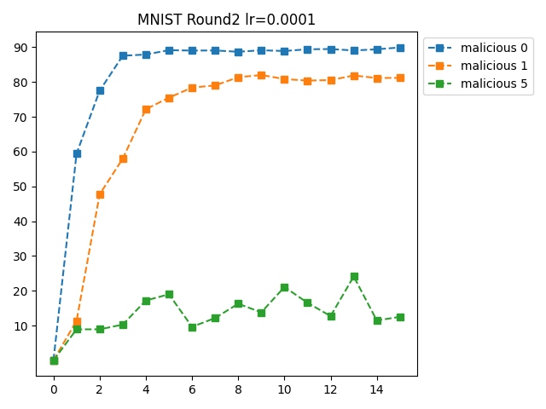
MNIST ROUND2

Slide 8
MNIST malicious1
MNIST malicious0
shard | 1 | 2 | 3 | 4 | 5 | 6 | 7 | 8 | 9 | 10 | 11 | 12 | 13 | 14 | 15
shard1 | 21.14 | 21.14 | 21.15 | 21.26 | 21.21 | 21.2 | 21.44 | 23.13 | 21.64 | 22.48 | 23.28 | 22.02 | 23 | 23.28 | 22.66
shard2 | 20.18 | 20.42 | 20.41 | 20.41 | 20.5 | 20.76 | 20.42 | 20.49 | 20.59 | 20.79 | 21.08 | 21.71 | 22.4 | 20.9 | 22.76
shard3 | 18.73 | 18.74 | 18.74 | 18.74 | 18.8 | 19.14 | 18.87 | 19.07 | 18.93 | 20.16 | 19.04 | 18.85 | 20.47 | 18.86 | 19.07
shard4 | 53.97 | 19.86 | 19.86 | 20.1 | 20.31 | 25.52 | 20.33 | 24.54 | 21.77 | 21.15 | 21.61 | 23.92 | 28.34 | 25.58 | 23.89
shard5 | 23.83 | 19.8 | 19.8 | 19.8 | 19.84 | 20.06 | 20.89 | 20.28 | 19.97 | 20.2 | 20.43 | 21.34 | 20.28 | 21.46 | 21.03
FedAvg | 59.4 | 77.49 | 87.54 | 87.89 | 89.15 | 89.02 | 89.06 | 88.68 | 89.11 | 88.9 | 89.4 | 89.47 | 89.05 | 89.39 | 89.92
MNIST malicious1
shard | 1 | 2 | 3 | 4 | 5 | 6 | 7 | 8 | 9 | 10 | 11 | 12 | 13 | 14 | 15
shard1 | 21.13 | 21.15 | 21.15 | 21.14 | 21.14 | 21.14 | 21.15 | 21.14 | 21.14 | 21.15 | 21.41 | 21.23 | 23.58 | 21.27 | 23.33
shard2 | 20.2 | 20.36 | 20.37 | 20.38 | 20.38 | 20.39 | 20.39 | 20.37 | 20.4 | 20.39 | 20.37 | 20.39 | 20.4 | 20.39 | 20.4
shard3 | 18.72 | 18.73 | 18.74 | 18.74 | 18.74 | 18.74 | 18.74 | 18.74 | 18.74 | 18.74 | 18.74 | 18.74 | 18.81 | 18.74 | 18.74
shard4 | 19.76 | 19.83 | 19.83 | 19.83 | 19.85 | 19.86 | 19.86 | 19.86 | 19.86 | 19.91 | 21.41 | 20.08 | 20.09 | 20.44 | 19.93
shard5 | 19.22 | 19.39 | 19.56 | 19.59 | 19.67 | 19.77 | 19.68 | 19.66 | 19.71 | 19.72 | 19.77 | 19.76 | 19.7 | 19.78 | 19.75
FedAvg | 11.35 | 47.72 | 57.95 | 72.16 | 75.49 | 78.39 | 79.01 | 81.36 | 82.01 | 80.84 | 80.4 | 80.54 | 81.86 | 81.15 | 81.17

Slide 9
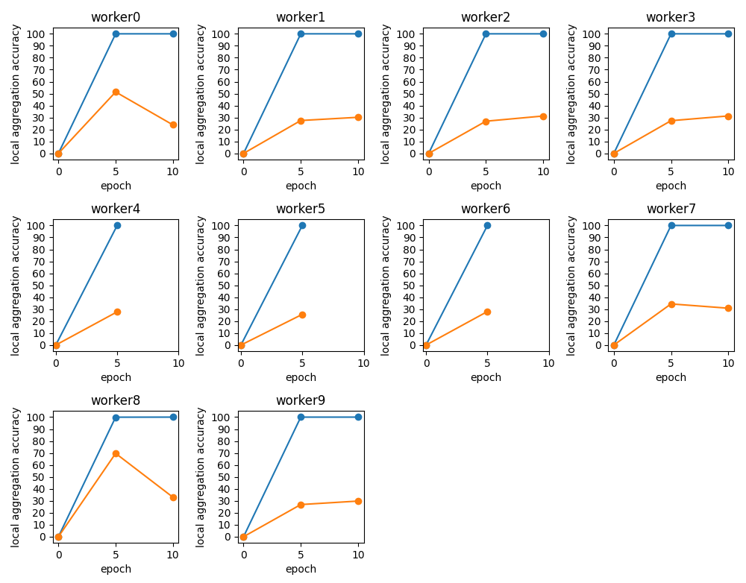
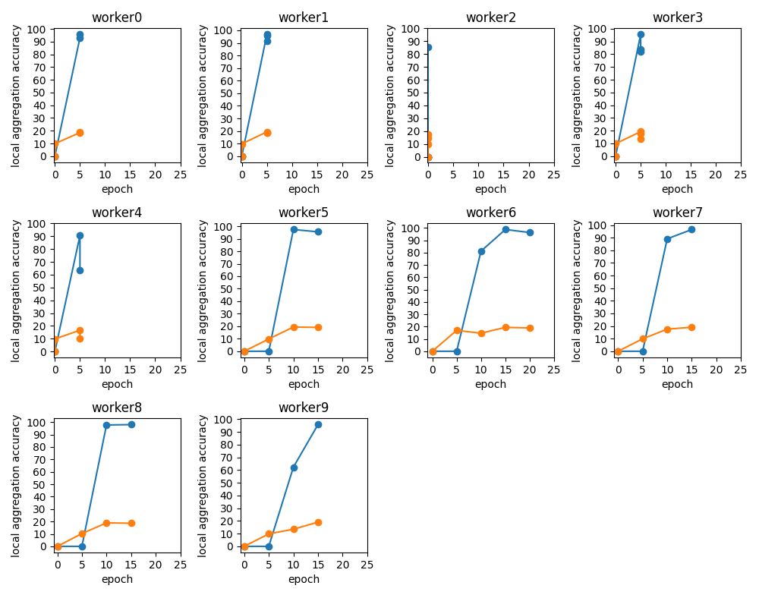
shard4 15block malicious0 – malicious1

Slide 10
e.g. shard4 malicious
0 | 80
1 | 85
2 | 70
3 | 87
4 | 76
5 | 82
6 | 99
7 | 99
8 | 83
9 | 86
0 | 0
1 | 11
2 | 10
3 | 12
4 | 13
5 | 0
6 | 99
7 | 99
8 | 0
9 | 12

Slide 11
solution
각 label마다 데이터를 1개씩 넣는다.
black list 를 설정한다.

